Slide 1
Dino-yes or dino-no?

Slide 2
Dinosaurs roamed the earth from 250 to 65 million years ago. They were not the only animals around at that time.
Which of these animals from National Museums Scotland are dino-yes and which are dino-no?

Slide 3
Three sharp horns helped this animal to defend itself against ferocious predators.
1
Notes:
Send the image to the back to keep the logo (in footer box) on top of the image

Slide 4
2
You’d have to look up to see this Jurassic flyer. Its wings were formed by skin stretched over its front limbs.​
Notes:
Send the image to the back to keep the logo (in footer box) on top of the image

Slide 5
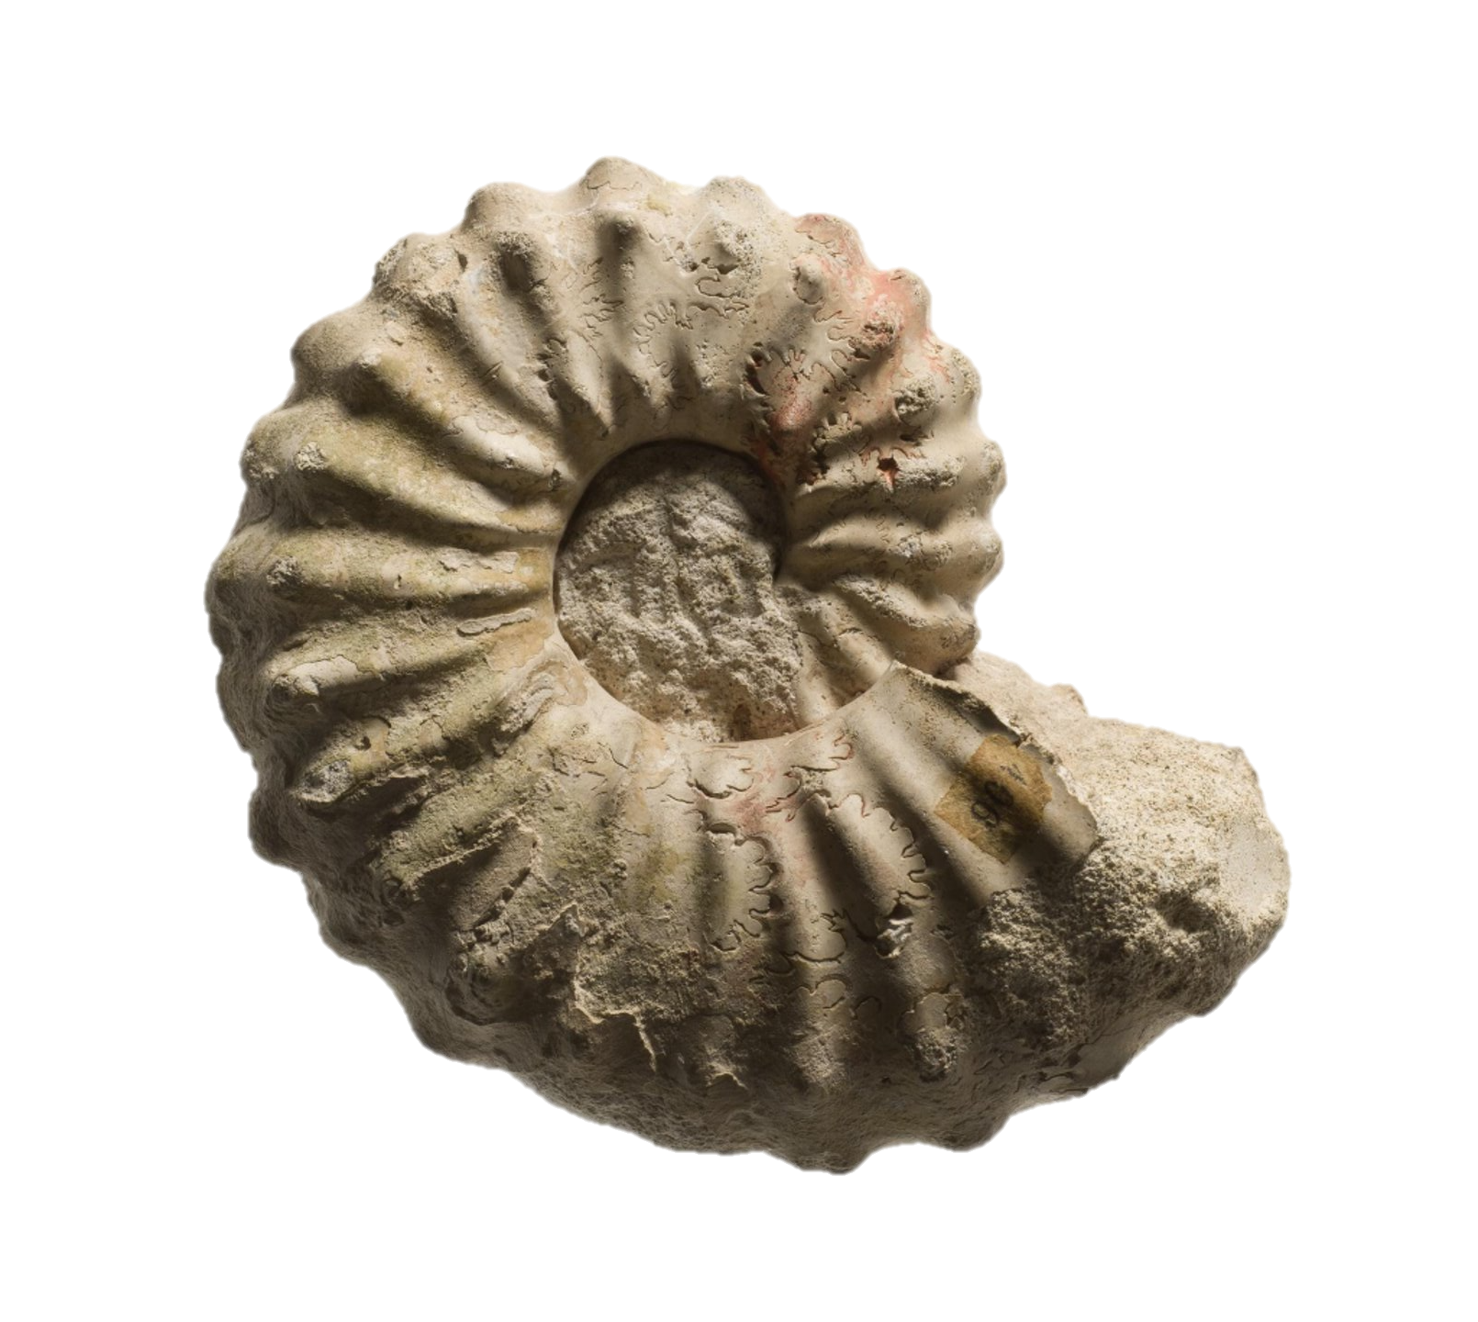
3
These curly creatures lived in the sea and could be up to two metres long.​
​
Notes:
Send the image to the back to keep the logo (in footer box) on top of the image

Slide 6
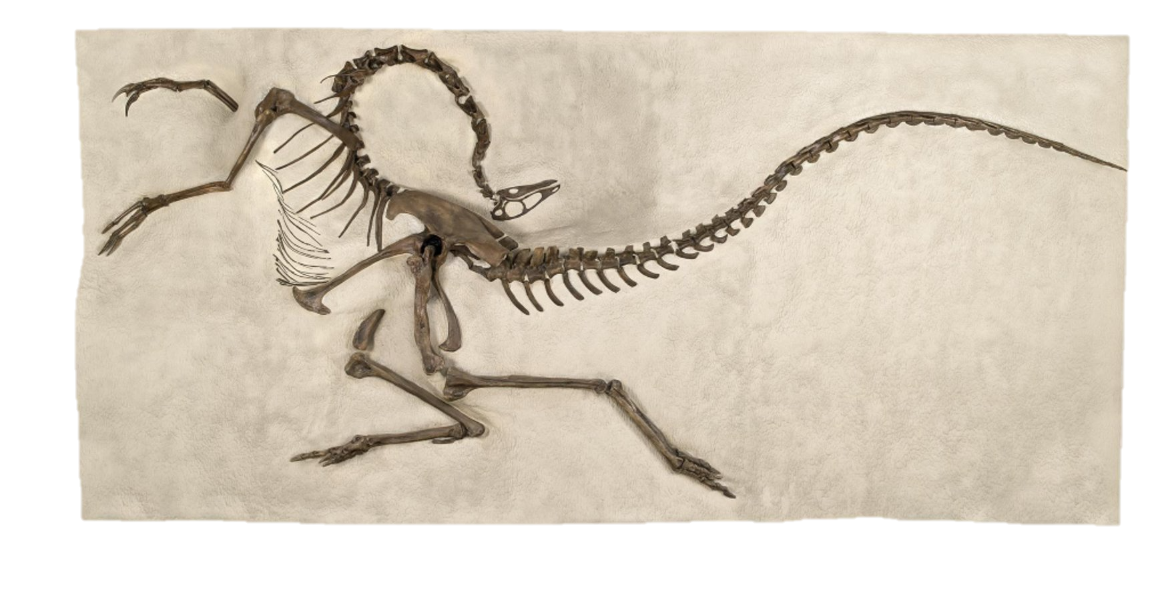
The name of this fast runner means “ostrich mimic”. Like its namesake, it was super-speedy. ​
4
Notes:
Send the image to the back to keep the logo (in footer box) on top of the image

Slide 7
This animal was well-protected, with four long spikes on the end of its tail. Bony plates along its back made it look even more impressive.​
5

Slide 8
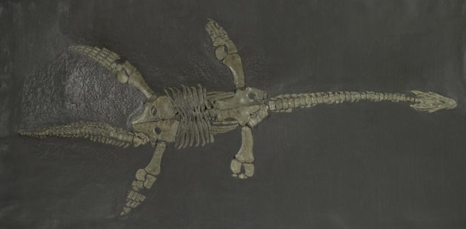
6
Four large flippers helped this animal to swim swiftly through the sea.

Slide 9
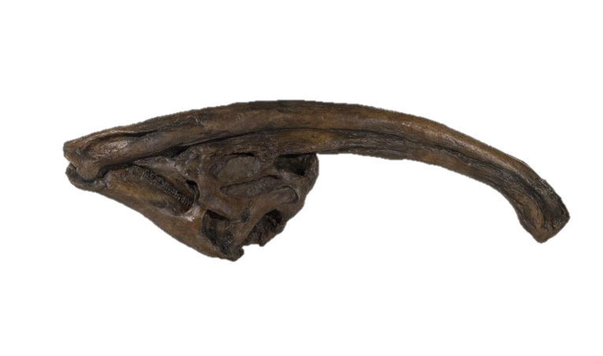
7
This bony crest forms part of the animal’s skull. It is thought to be used for making sounds, a bit like a musical horn.

Slide 10
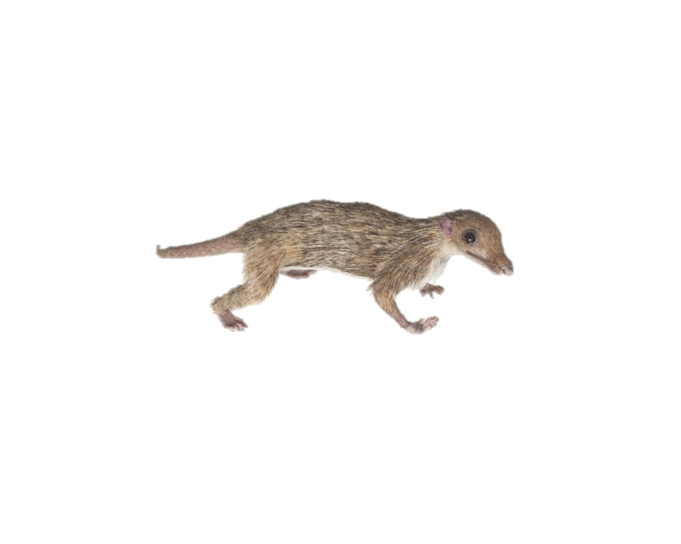
8
Not all pre-historic animals were huge. This tiny creature was only about the size of a small mouse.

Slide 11
9
Can you find the animal’s eye? This would have been helpful for it seeing clearly in deep water.

Slide 12
10
This fearsome carnivore had extra-strong teeth which could crunch through bone!

Slide 13
Let’s find out!

Slide 14
Dino-yes!
Triceratops (Cretaceous Era)​ was a herbivore who often had to defend itself from predatory carnivores.
1
Notes:
Triceratops: try-serra-tops

Slide 15
2
Dino-no!
Pterosaurs (Jurassic Era) ​were neither dinosaurs nor birds. Instead they were flying reptiles.
Notes:
Pterosaur: ter-oh-sore

Slide 16
3
Dino-no!
Ammonites (Cretaceous Era) ​were marine molluscs, related to squid, cuttlefish and octopuses.
Notes:
Ammonite: amma-night

Slide 17
Dino-yes!
Struthiomimus (Cretaceous
Era)​ belonged to a group
of dinosaurs called Ornithomimosaurs, which means “bird mimic lizards”.
4
Notes:
Struthiomimus: stroo-thee-oh-my-mus

Slide 18
Dino-yes!
Stegosaurus (Jurassic Era)​ had bony plates along its back and tail. They might have been used for defence, to control its body temperature, or to make it look more impressive!
5
Notes:
Stegosaurus: stegga-saw-rus

Slide 19
6
Dino-no!
Plesiosaurs (Jurassic Era)​ were large and powerful marine reptiles. They ate fish, squid and other sea-creatures, using their long necks to swipe at prey.
Notes:
Pliosaur: ply-oh-saur

Slide 20
7
Dino-yes!
Parasaurolophus (Cretaceous Era)​ had this bony crest on top of its head. Inside it was hollow, with different chambers and passages. These may have helped him to make deep, echoey sounds.
Notes:
Parasaurolophus: parra-saw-rollo-fus

Slide 21
8
Dino-no!
Morganucodon (late Triassic/early Jurassic Era)​ was one of the very earliest mammals. It liked to eat insects.
Notes:
Morganucodon: more-gan-you-co-don

Slide 22
9
Dino-no!
Ichthyosaur (Jurassic Era)​ was a marine reptile. The first complete Ichthyosaur fossil was found around 1811 by a twelve-year-old girl
called Mary Anning. As an adult, she became a famous fossil-collector.​
​
​
Notes:
Ichthyosaur: ick-thee-oh-sore

Slide 23
10
Dino-yes!
Tyrannosaurus rex (Cretaceous Era)​ has a reputation as a fearsome predator. However, palaeontologists are not completely sure whether it hunted or scavenged for its food.
Notes:
Tyrannosaurus rex: tie-ranna-saw-rus rex

Slide 24
Well done!
Find out more about dinosaurs and other animals by visiting nms.ac.uk
© National Museums Scotland, Scottish Charity, No. SC011130

